Slide 1

Landing on a Lee Shore

Slide 2
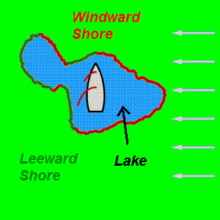
Why do we need to know this?
A Lee shore is the one that is downwind (Leeward), so that the wind is blowing from the water onto the land.
It is important, because you need to learn a technique to control the speed as you approach the shore.

Slide 3

STEP 1
From well upwind, take the end of the main halyard and throw it overboard.
SHORE

Slide 4
STEP 1
From well upwind, take the end of the main halyard and throw it overboard.
Then turn the boat towards the wind until you are head-to-wind.
SHORE

Slide 5

STEP 1
From well upwind, take the end of the main halyard and throw it overboard.
Then turn the boat towards the wind until you are head-to-wind.
Ease the Kicker, release the Cunningham then uncleat the main halyard to drop the main sail into the boat.
SHORE

Slide 6
STEP 1
From well upwind, take the end of the main halyard and throw it overboard.
Then turn the boat towards the wind until you are head-to-wind.
Ease the Kicker, release the Cunningham then uncleat the main halyard to drop the main sail into the boat.
Remove the halyard from the head of the main and secure.
SHORE

Slide 7

STEP 2
Sheet in the Jib and pull the tiller towards you, to bear away and back towards the shore.
SHORE

Slide 8
STEP 2
Sheet in the Jib and pull the tiller towards you, to bear away and back towards the shore.
Lift the centreboard and release the rudder's downhaul.
SHORE

Slide 9
STEP 2
Sheet in the Jib and pull the tiller towards you, to bear away and back towards the shore.
Lift the centreboard and release the rudder's downhaul.
As the water shallows release the jib and turn towards the wind.
SHORE

Slide 10
STEP 2
Sheet in the Jib and pull the tiller towards you, to bear away and back towards the shore.
Lift the centreboard and release the rudder's downhaul.
As the water shallows release the jib and turn towards the wind.
Crew steps out and secures the boat head to wind.
SHORE

Slide 11
Recap & Questions
1) Head to wind and drop the main
2) Head to shore and lift the foils
3) Release jib and step out
Landing on a Lee shore... DONE!

